Slide 1
LECTURE # 4
CHAPTER # 1

Slide 2
Rules of Inference

Slide 3
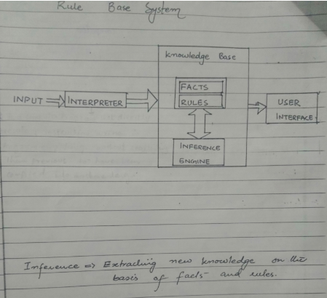

Slide 4
Rules of Inference
Templates for constructing valid arguments
Our basic tools for establishing the truth of statements
Fallacies
common forms of incorrect reasoning which lead to invalid arguments

Slide 5
Rules of Inference
An argument in propositional logic is a sequence of propositions.
All but the final proposition in the argument are called
premises and the final proposition is called the conclusion.
An argument is valid if the truth of all its premises implies that the conclusion is true.

Slide 6
Rules of Inference
An argument form in propositional logic is a sequence of compound propositions involving propositional variables.
An argument form is valid no matter which particular propositions are substituted for the propositional variables in its premises, the conclusion is true if the premises are all true.

Slide 7
Example
“If you have a current password, then you can log onto the network.”
Valid Arguments in Propositional Logic
“You have a current password.”
Therefore,
“You can log onto the network.”

Slide 8
Example
Argument form:
p → q p
PREMISES
∴ q
CONCLUSION
where ∴ is the symbol that denotes “therefore.”

Slide 9
Example
To determine whether this is a valid argument, determine whether the conclusion
“You can log onto the network” is true
when the premises “If you have a current password, then you can log onto the network” and “You have a current password”
are both true.

Slide 10
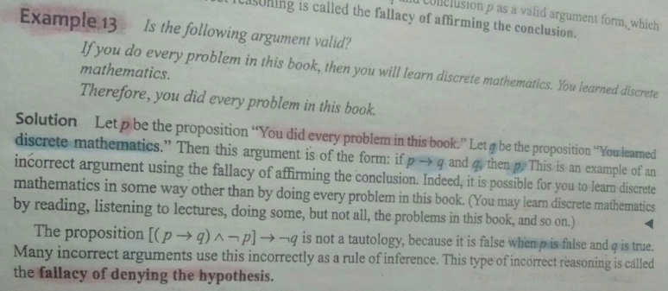

Slide 11
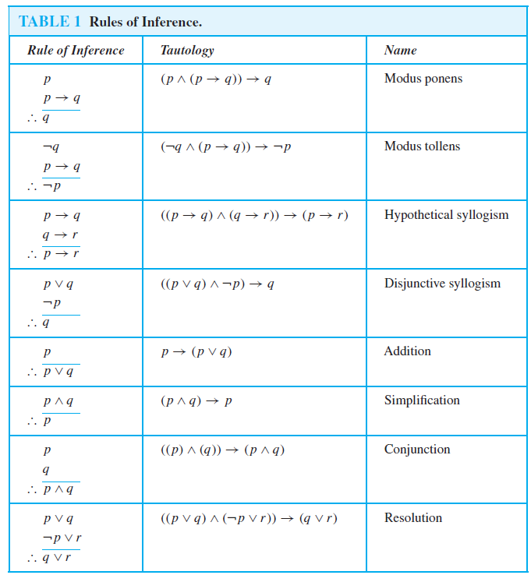

Slide 12
Example
State which rule of inference is the basis of the following argument:
“ It is below freezing now.
Therefore, it is either below freezing or raining now. ”

Slide 13
Solution
“ It is below freezing now.
Therefore, it is either below freezing or raining now. ”
Let p be the proposition “It is below freezing now. ” and q be the proposition “It is raining now. ”
Then this argument is of the form
p
This is an argument that uses the addition rule
∴ p V q

Slide 14
Example
State which rule of inference is the basis of the following argument:
“ It is below freezing and raining now. Therefore, it is below freezing now. ”

Slide 15
Solution
“ It is below freezing and raining now. Therefore, it is below freezing now. ”
Let p be the proposition “It is below freezing now. ” and q be the proposition “It is raining now. ”
Then this argument is of the form
p ∧ q
This is an argument that uses the simplification rule
∴ p

Slide 16
Example
State which rule of inference is used in the argument:
“ If it rains today, then we will not have a barbeque today.
If we do not have a barbeque today, then we will have a barbecue tomorrow.
Therefore, if it rains today, then we will have a barbecue tomorrow. ”

Slide 17
Solution
Let p be the proposition “It is raining today. ”
let q be the proposition “We will not have a barbecue today.” and r be the proposition “We will have a barbecue tomorrow.”
Then the argument is of the given form:
p → q
q → r
This argument is a
hypothetical syllogism
∴ p → r

Slide 18
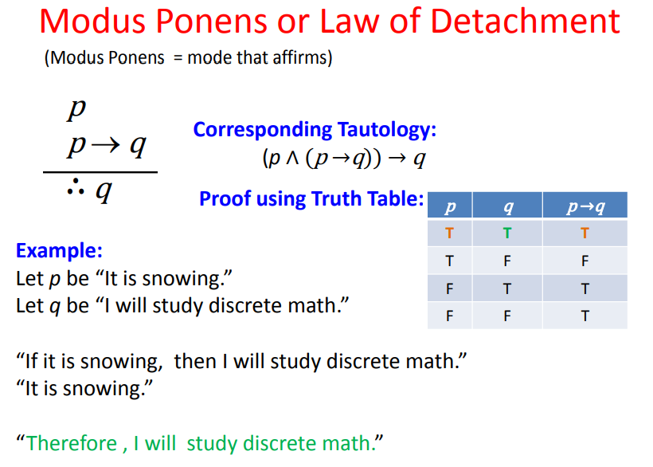

Slide 19
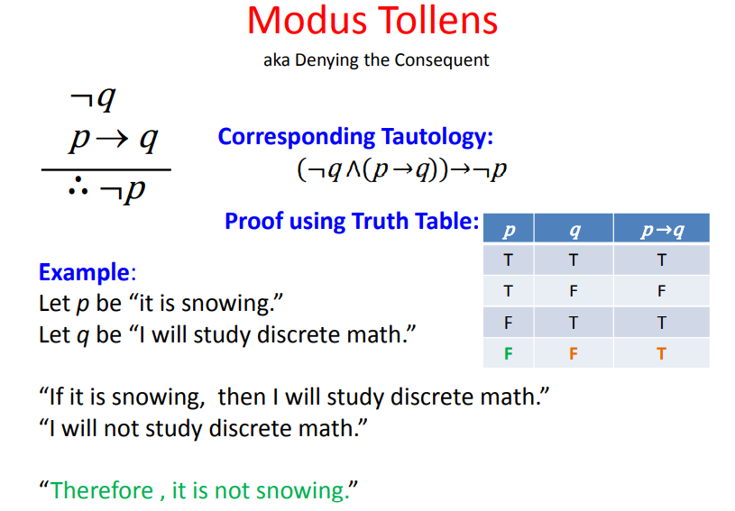

Slide 20
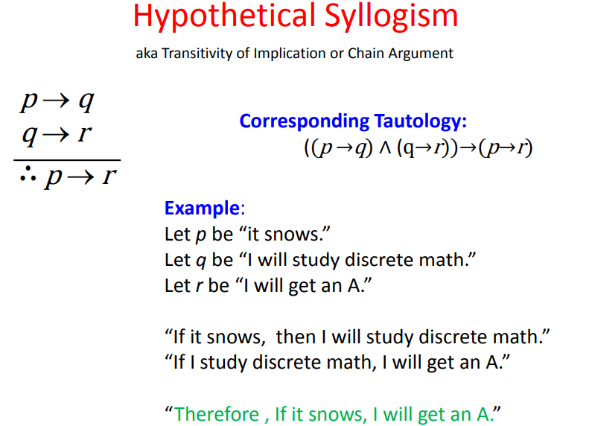

Slide 21
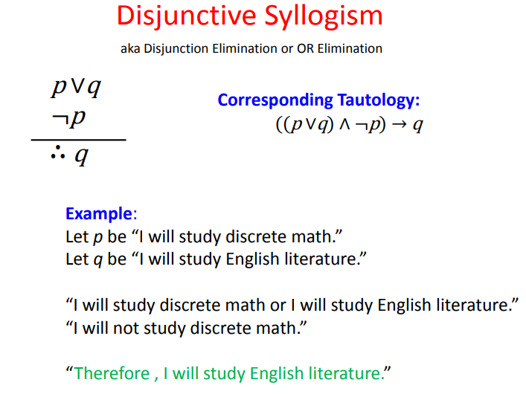

Slide 22
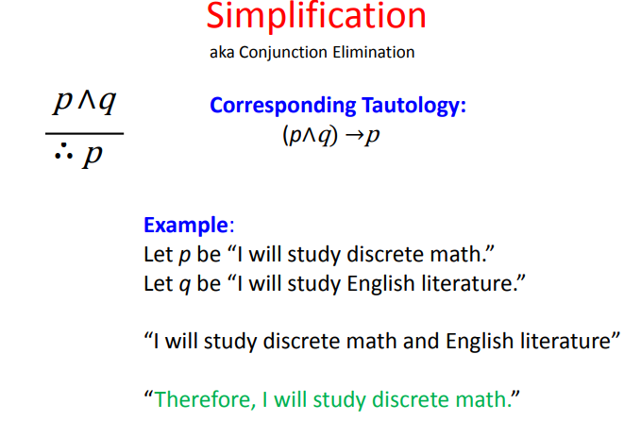

Slide 23
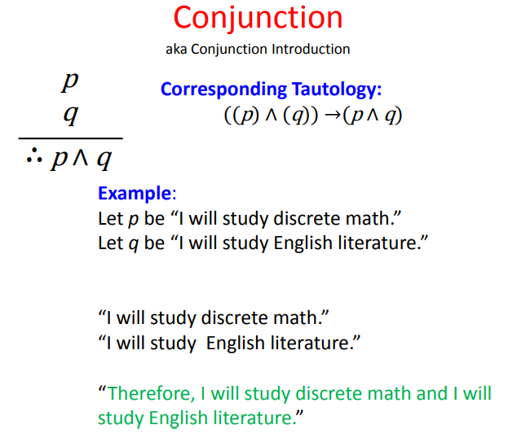

Slide 24
Formal Proof
Definition 2
A formal proof of a conclusion q given hypotheses p₁, p₂, . . . , p_{n} is a sequence of steps, each of which applies some inference rule to hypotheses or previously proven statements (antecedents) to yield a new true statement (the consequent).
A formal proof demonstrates that if the premises are true, then the conclusion is true.

Slide 25
Example
Using Rules of Inference to Build Arguments
Show that the premises:
“It is not sunny this afternoon and it is colder than yesterday,” “We will go swimming only if it is sunny,”
“If we do not go swimming, then we will take a canoe trip,” and “If we take a canoe trip, then we will be home by sunset”
lead to the conclusion “We will be home by sunset.”

Slide 26
Solution
Let
p be the proposition “It is sunny this afternoon,” q the proposition “It is colder than yesterday,”
r the proposition “We will go swimming,”
s the proposition “We will take a canoe trip,”
and t the proposition “We will be home by sunset.”

Slide 27
Solution
Let p be the proposition “It is sunny this afternoon,” q the proposition “It is colder than yesterday,”
r the proposition “We will go swimming,”
s the proposition “We will take a canoe trip,”
and t the proposition “We will be home by sunset.”
“It is not sunny this afternoon and it is colder than yesterday”
￢p ∧ q

Slide 28
Solution
Let p be the proposition “It is sunny this afternoon,” q the proposition “It is colder than yesterday,”
r the proposition “We will go swimming,”
s the proposition “We will take a canoe trip,”
and t the proposition “We will be home by sunset.”
“We will go swimming only if it is sunny.” r → p

Slide 29
Solution
Let p be the proposition “It is sunny this afternoon,” q the proposition “It is colder than yesterday,”
r the proposition “We will go swimming,”
s the proposition “We will take a canoe trip,”
and t the proposition “We will be home by sunset.”
“If we do not go swimming, then we will take a canoe trip.”
￢r → s

Slide 30
Solution
Let p be the proposition “It is sunny this afternoon,” q the proposition “It is colder than yesterday,”
r the proposition “We will go swimming,”
s the proposition “We will take a canoe trip,”
and t the proposition “We will be home by sunset.”
“If we take a canoe trip, then we will be home by sunset.” s → t

Slide 31
Solution
Let p be the proposition “It is sunny this afternoon,” q the proposition “It is colder than yesterday,”
r the proposition “We will go swimming,”
s the proposition “We will take a canoe trip,”
and t the proposition “We will be home by sunset.”
Conclusion: “We will be home by sunset.” t

Slide 32
Solution
The premises become
￢p ∧ q
r → p
￢r → s s → t
The conclusion is simply t

Slide 33
Solution
We construct an argument to show that our premises lead to the desired conclusion as follows.
Step Reason
1.
2.
3.
4.
5.
6.
7.
8.
￢p ∧ q
￢p
r → p
￢r
￢r → s
s
s → t
t
Premise
Simplification using (1) Premise
Modus tollens using (2) and (3) Premise
Modus ponens using (4) and (5)
Premise
Modus ponens using (6) and (7)

Slide 34
Example
Show that the premises:
“If you send me an e-mail message, then I will finish writing the program,”
“If you do not send me an e-mail message, then I will go to sleep early,” and
“If I go to sleep early, then I will wake up feeling refreshed”
lead to the conclusion “If I do not finish writing the program, then I will wake up feeling refreshed.”

Slide 35
Solution
Let p be the proposition “You send me an e-mail message,” q the proposition “I will finish writing the program,”
r the proposition “I will go to sleep early,”
and s the proposition “I will wake up feeling refreshed.”
“If you send me an e-mail message, then I will finish writing the program”
p → q

Slide 36
Solution
Let p be the proposition “You send me an e-mail message,” q the proposition “I will finish writing the program,”
r the proposition “I will go to sleep early,”
and s the proposition “I will wake up feeling refreshed.”
“If you do not send me an e-mail message, then I will go to sleep early”
￢p → r

Slide 37
Solution
Let p be the proposition “You send me an e-mail message,” q the proposition “I will finish writing the program,”
r the proposition “I will go to sleep early,”
and s the proposition “I will wake up feeling refreshed.”
“If I go to sleep early,
then I will wake up feeling refreshed”
r → s

Slide 38
Solution
Let p be the proposition “You send me an e-mail message,” q the proposition “I will finish writing the program,”
r the proposition “I will go to sleep early,”
and s the proposition “I will wake up feeling refreshed.”
Conclusion: “If I do not finish writing the program, then I will wake up feeling refreshed”
￢q → s

Slide 39
Solution
The premises are
p → q
￢ p → r
r → s
The desired conclusion is ￢ q → s

Slide 40
Solution
The premises are
p → q
￢ p → r
r → s
The desired conclusion is ￢ q → s
We need to give a valid argument with premises p → q, ￢p → r, and r → s and conclusion ￢q → s

Slide 41
Solution
This argument form shows that the premises lead to the desired conclusion.
Step Reason
1.
2.
3.
4.
5.
6.
p → q
￢q →￢p
￢p → r
￢q → r r → s
￢q → s
Premise Contrapositive of (1) Premise
Hypothetical syllogism using (2) and (3) Premise
Hypothetical syllogism using (4) and (5)

